Slide 1
AVL Examples

Slide 2
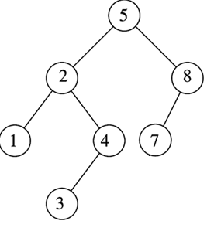
Insert 6, Maintain Balanced Factor

Slide 3
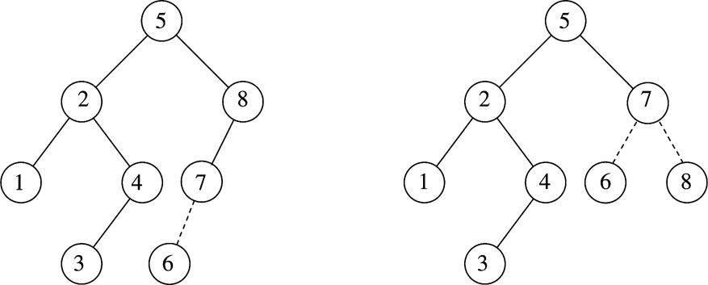
Insert 6, Maintain Balanced Factor Left to Left Rotation Pivot Node =8 Clockwise Rotation about Pivot Node

Slide 4
Example
Inserting 3, 2, 1, and then 4 ,5,6,7 sequentially into empty AVL tree

Slide 5
Example
Inserting 3, 2, 1, and then 4 ,5,6,7 sequentially into empty AVL tree
3
2
2
1
3
1
Insert 1,
Left to Left Rotation Pivot Node =3 Clockwise Rotation about Pivot Node

Slide 6
Example (Cont’d)
Inserting 4
Inserting 5
2
1
3
4
Insert 5,
Right to Right Rotation Pivot Node =3 Anticlockwise Rotation about Pivot Node
2
2
1
3
4
1
4
5
3
5

Slide 7
Example (Contd)
Insert 6,
Right to Right Rotation Pivot Node =2 Anticlockwise Rotation about Pivot Node
Inserting 6
Inserting 7
4
2
2
5
1
4
1
3
6
3
5
Insert 7,
Right to Right Rotation Pivot Node =5 Anticlockwise Rotation about Pivot Node
6
4
4
2
6
2
5
1
3
5
7
1
3
6
7

Slide 8
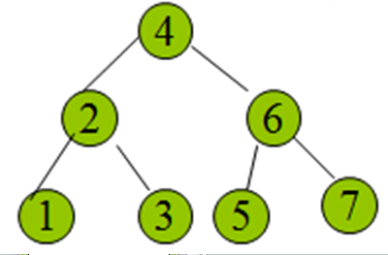
Example
Continuing the previous example by inserting
16 down to 10, and then 8 and 9
Notes:
8

Slide 9
Example
Inserting 16 and 15
Insert 15,
Right to Left Rotation Pivot Node =7 First Perform Left to Left Rotation around node A=>Clockwise
Then Right to Right rotation around pivot node P=>Anti-Clockwise
4
2
6
7
P
1
3
5
16
A
15
9
Notes:
9

Slide 10
Example
Inserting 16 and 15
Insert 15,
Right to Left Rotation Pivot Node =7 First Perform Left to Left Rotation around node A=>Clockwise
4
4
2
6
2
6
7
P
1
3
5
7
P
1
3
5
15
16
A
15
16
10
Notes:
10

Slide 11
Example
Inserting 16 and 15
Insert 15,
Right to Left Rotation Pivot Node =7 Then Right to Right rotation around pivot node P=>Anti-Clockwise
4
4
2
6
2
6
15
P
1
3
5
7
P
1
3
5
16
7
15
16
11
Notes:
11

Slide 12
Example (Contd)
Inserting 14
4
2
6
P
15
A
1
3
5
7
16
14
Insert 14,
Right to Left Rotation Pivot Node =6 First Perform Left to Left Rotation around node A=>Clockwise
Then Right to Right rotation around pivot node P=>Anti-Clockwise
12
Notes:
12

Slide 13
Example (Contd)
Inserting 14
4
4
2
6
P
2
6
P
A
7
A
1
3
5
15
1
3
5
15
7
16
14
16
14
Insert 14,
Right to Left Rotation Pivot Node =6 First Perform Left to Left Rotation around node A=>Clockwise
13
Notes:
13

Slide 14
Example (Contd)
Inserting 14
4
4
2
6
P
2
7
7
A
1
3
6
15
1
3
5
15
16
5
14
14
16
Insert 14,
Right to Left Rotation Pivot Node =6 Then Right to Right rotation around pivot node P=>Anti-Clockwise
14
Notes:
14

Slide 15
Double Rotation
Insert 18
0
10
1
-1
5
15
-1
0
0
0
2
9
12
20
0
0
0
3
17
30
Notes:
So, we’ll double rotate.
Start by moving the offending grand-child up.
We get an even more imbalanced tree.
BUT, it’s imbalanced like a zig-zig tree now!

Slide 16
Double Rotation
Inserting 18
Right to Left Rotation Pivot Node =15 First Perform Left to Left Rotation around node A=>Clockwise
Then Right to Right rotation around pivot node P=>Anti-Clockwise
-1
10
1
-2
5
15
P
-1
0
0
1
2
9
12
20
A
0
-1
0
3
17
30
0
18
Notes:
So, we’ll double rotate.
Start by moving the offending grand-child up.
We get an even more imbalanced tree.
BUT, it’s imbalanced like a zig-zig tree now!

Slide 17
Double Rotation (Step #1)
-1
-1
10
10
1
-2
1
-2
5
15
5
15
-1
0
0
1
-1
0
0
-2
2
9
12
20
2
9
12
17
0
-1
0
0
0
3
17
30
3
20
0
0
0
18
18
30
Notes:
So, we’ll double rotate.
Start by moving the offending grand-child up.
We get an even more imbalanced tree.
BUT, it’s imbalanced like a zig-zig tree now!

Slide 18
Double Rotation (Step #2)
-1
0
10
10
1
-2
1
0
5
15
5
17
-1
0
0
-2
-1
0
1
0
2
9
12
17
2
9
15
20
0
0
0
0
0
0
3
20
3
12
18
30
0
0
18
30
Notes:
So, let’s pull 17 up again.
Now, we get a balanced tree.
And, again, 10’s height didn’t need to change.

